Slide 1
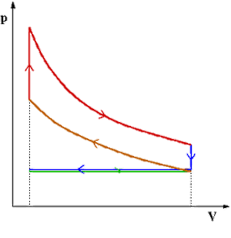
Engine Thermodynamics AEN/TSM 220
Pressure in Chamber
Modifying the Curves
Real Performance/Efficiency

Slide 2
Pressures in Combustion Chamber

Slide 3
Cycles

Slide 4
Power

Slide 5
Modifications

Slide 6
Autoignition Pressure

Slide 7
Intake/Exhaust Strokes

Slide 8
Real Shapes

Slide 9
Energy Loss

