Slide 1
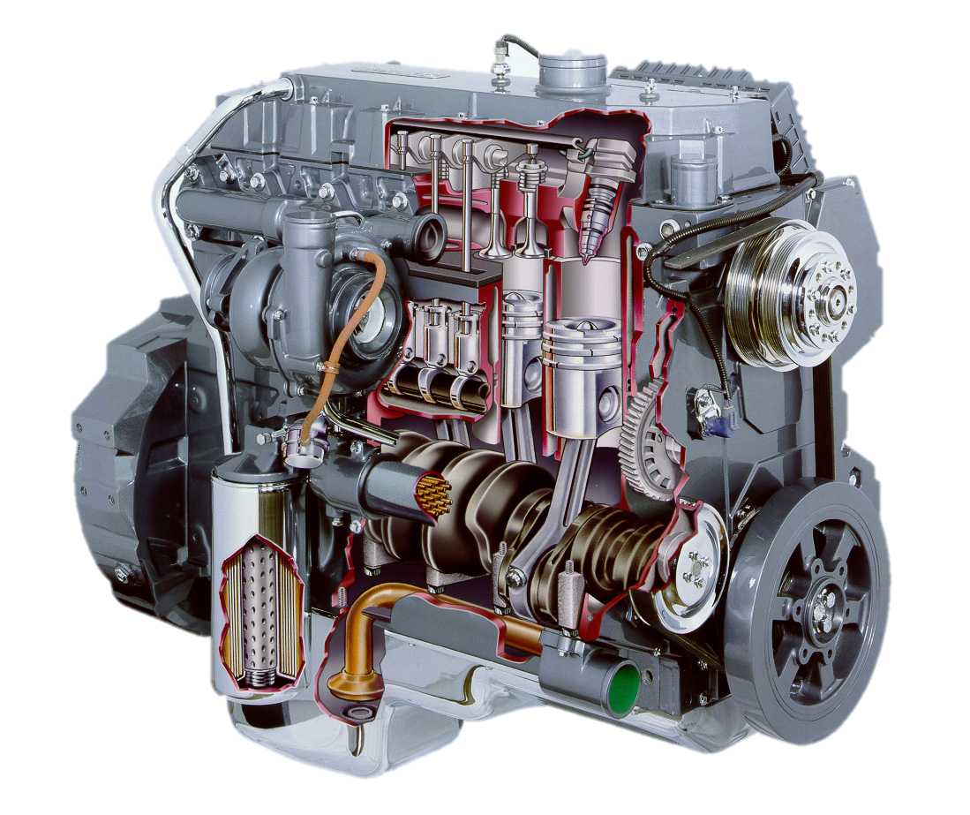
Combustion Process AEN/TSM 220
Combustion Theory
Air/Fuel Ratios
Causes of Emissions
Emission Control

Slide 2
Combustion Facts
Oxidization process
Fuel + Oxygen in
Carbon Dioxide + Water out
Equation:
C?H?O + O₂ → CO₂ + H₂O
C?H?O + O₂ + N₂ → CO₂ + H₂O + N₂

Slide 3
C₈H₁₈ + O₂ + N₂ → CO₂ + H₂O + N₂

Slide 4
C₂H₆ O + O₂ + N₂ → CO₂ + H₂O + N₂

Slide 5
Combustion Process AEN/TSM 220
Combustion Theory
Air/Fuel Ratios
Causes of Emissions
Emission Control

Slide 6
Air/Fuel Ratio AEN/TSM 220
Stoichiometric
Sometimes we deviate
Fuel chemistry changes A/F
Atomic Weights
H = 1
C = 12
N = 14
O = 16

Slide 7
C₈H₁₈ + 12.5 O₂ + 47 N₂ → 8 CO₂ + 9 H₂O + 47 N₂

Slide 8
C₂H₆ O + 3 O₂ + 11.3 N₂ → 2 CO₂ + 3 H₂O + 11.3 N₂

Slide 9
Combustion Process AEN/TSM 220
Combustion Theory
Air/Fuel Ratios
Causes of Emissions
Emission Control

Slide 10
C?H? O + O₂ + N₂ → CO₂ + H₂O + N₂

Slide 11
Combustion Process AEN/TSM 220
Combustion Theory
Air/Fuel Ratios
Causes of Emissions
Emission Control

Slide 12
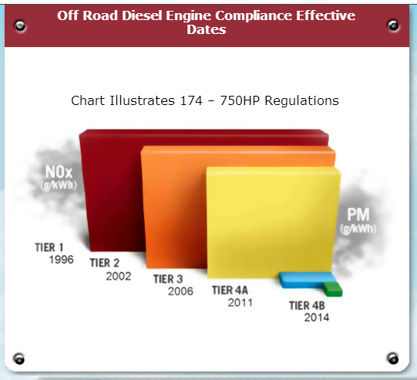
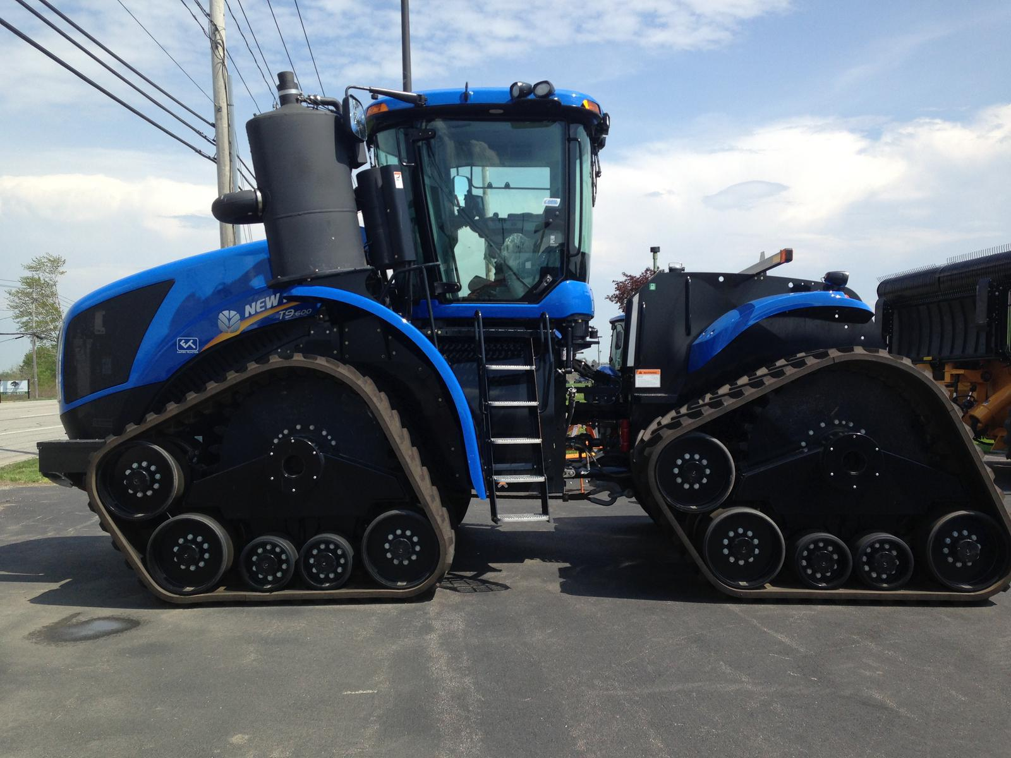
EPA Emission Requirements

Slide 13
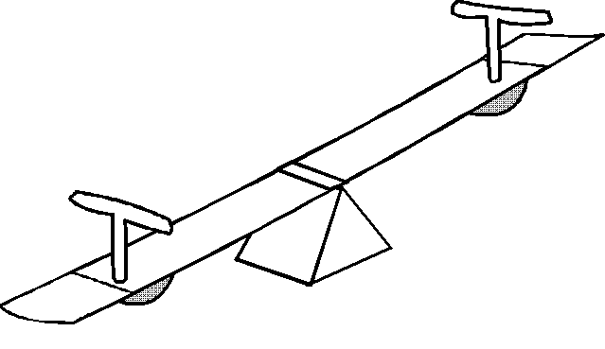
Emission Trade-offs
High Combustion Efficiency
High combustion temperatures
Reduced smoke
More NO_{x} production
Lower Combustion Temperature
Reduce NO_{x}
Lower efficiency
Soot (carbon particulates)

Slide 14
Mitigation
Engine/vehicle integrated control
Injection timing
Multiple injections
Integration with transmission (load)
Exhaust treatment strategies:
EGR: Exhaust Gas Recirculation
DPF: Diesel Particulate Filter
SCR: Selective Catalytic Reduction

Slide 15
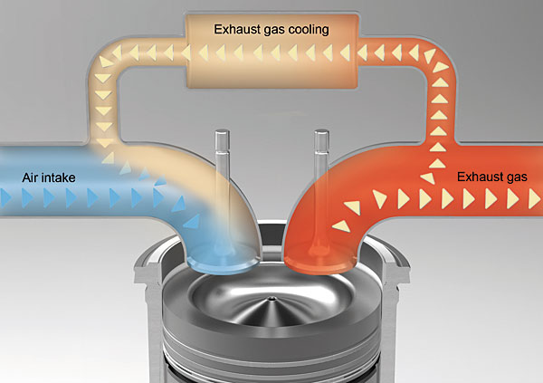
Exhaust Gas Recirculation
Recirculate some exhaust gas
Lowers combustion T
Reduces NO_{x}
Reduces power and/or efficiency
Soot (carbon) production

Slide 16
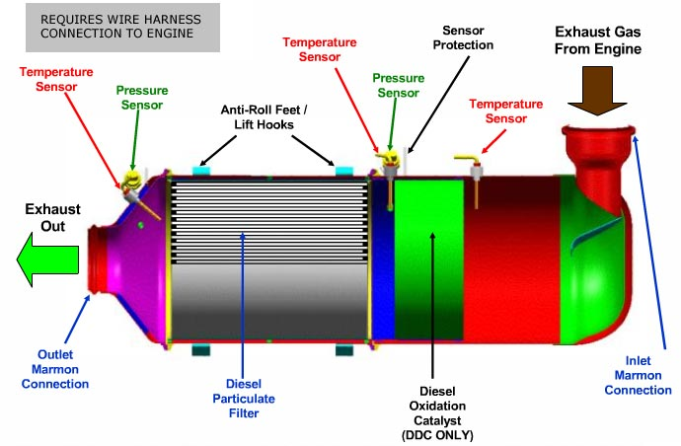
Diesel Particulate Filter
Ceramic wall traps carbon
Periodic regeneration

Slide 17
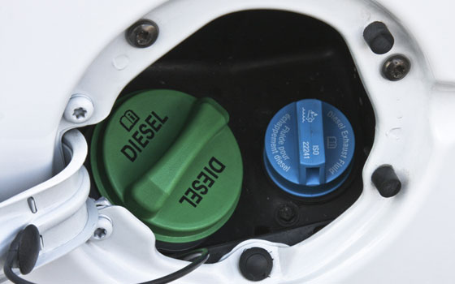
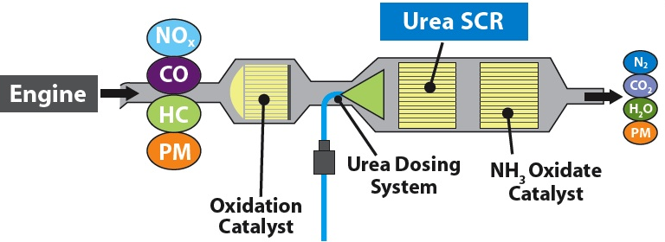
Selective Catalytic Reduction
Reduces NOx to N
Uses Diesel Exhaust Fluid (DEF) (Urea 32.5%)
Requires pumps and heaters

Slide 18
Summary
Where emissions come from
How we fix them
Improve combustion process
EGR
SCR

