Slide 1
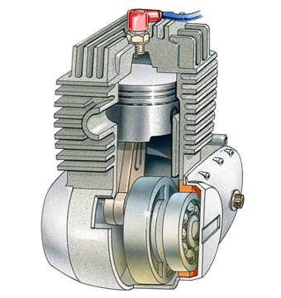
Cooling
AEN/TSM 220
Why we need it
Basic system types
  Air
  Liquid

Slide 2
Why do we need it?
Melting points of metals
  Aluminum: 1220 F
  Cast Iron: 2000 F
Thermal Efficiency

Slide 3
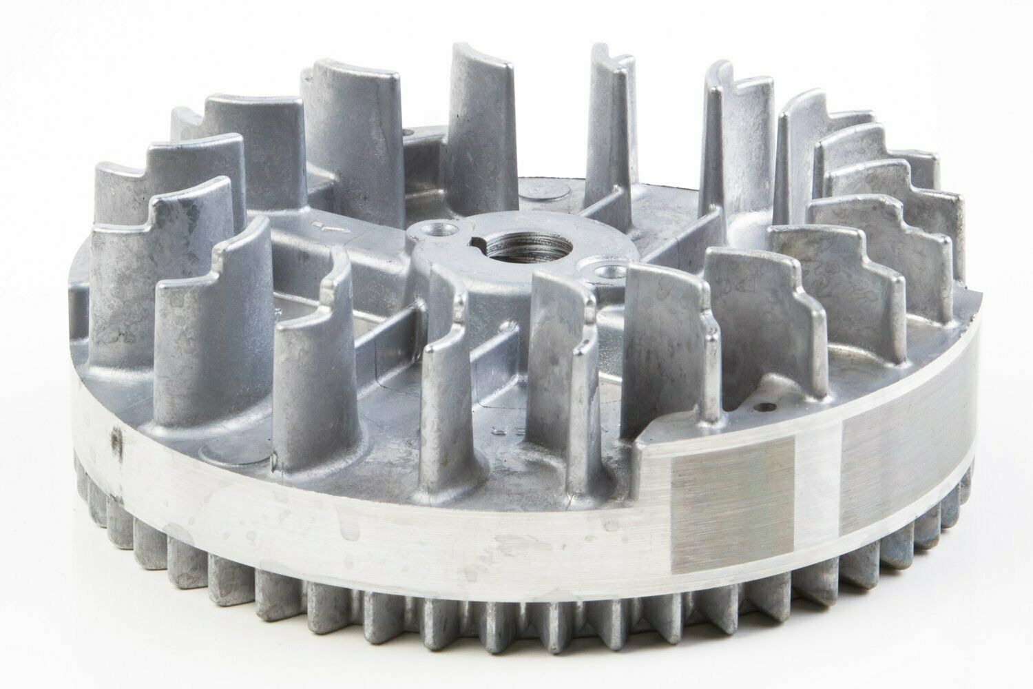
Air Cooling
Surface area
Air flow

Slide 4
Liquid Cooling
Liquid transfers better
Coolant

Slide 5
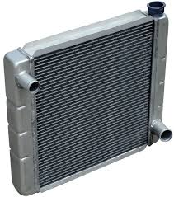
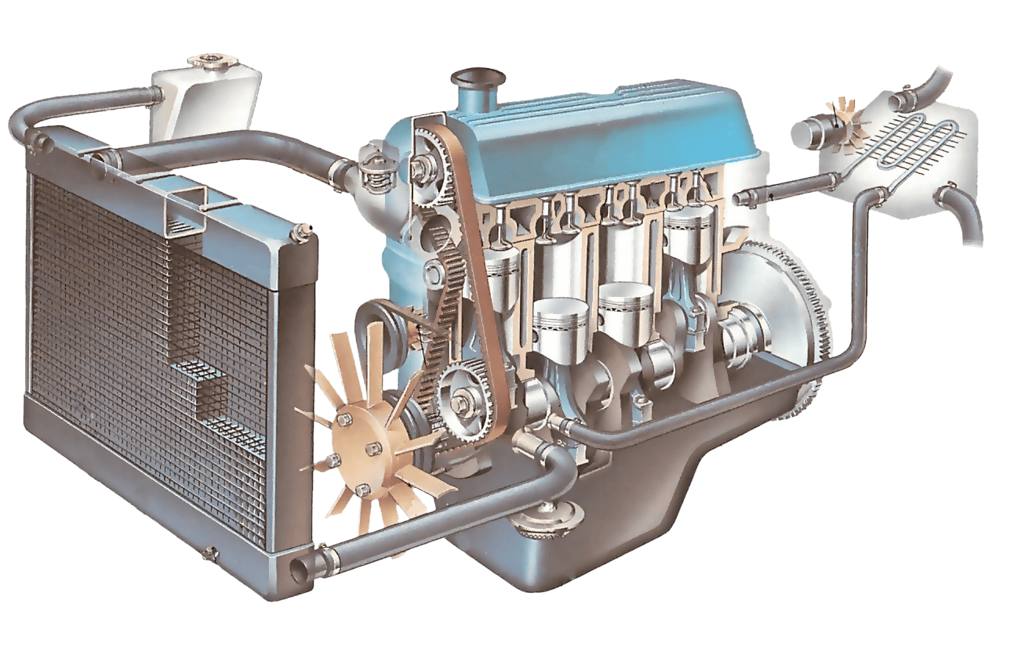
Radiator

Slide 6
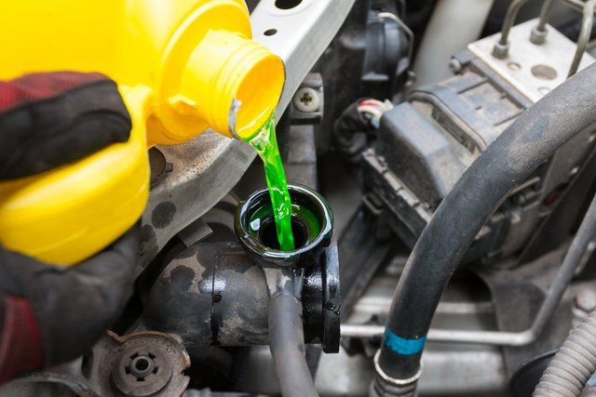
Coolant
Ethylene glycol
  Freeze protection
  Enhanced heat transfer
  Lubrication
  Corrosion protection
  Scale resistance

