Slide 1
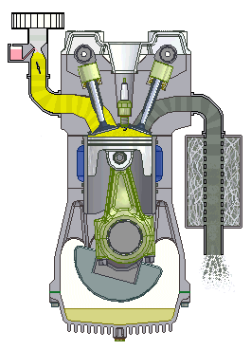
Ignition Systems
AEN/TSM 220
Fuel Properties
Spark Ignition
Compression Ignition

Slide 2
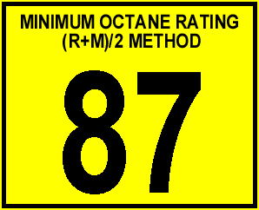
Autoignition
Pressure at which the fuel/air mixture will autoignite
Octane (Gasoline/Ethanol)
  Higher octane = higher ignition pressure
Cetane (Diesel)
  Higher cetane = lower ignition pressure

Slide 3
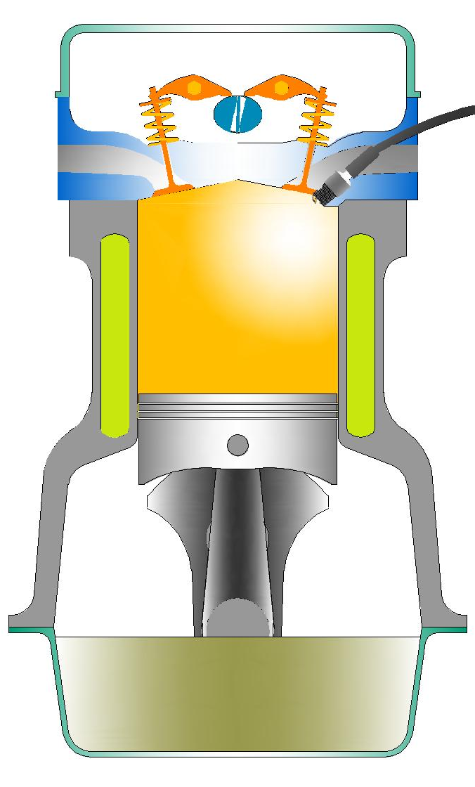
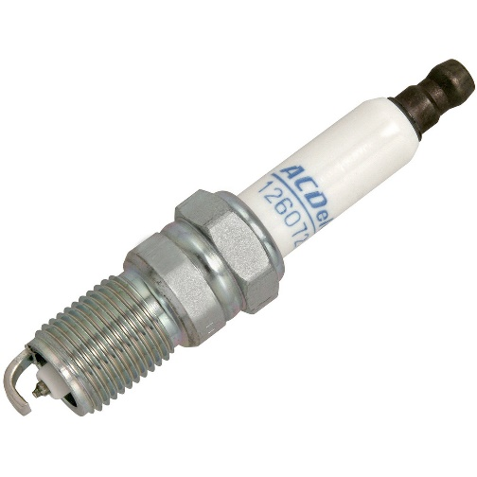
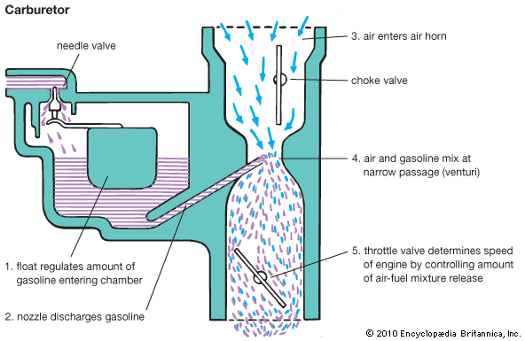
Spark Ignition
Air/Fuel mixture compressed in piston
Fuel delivery:
  Carburetors
  Fuel injection before cylinder
Compression Ratio: <10:1

Slide 4
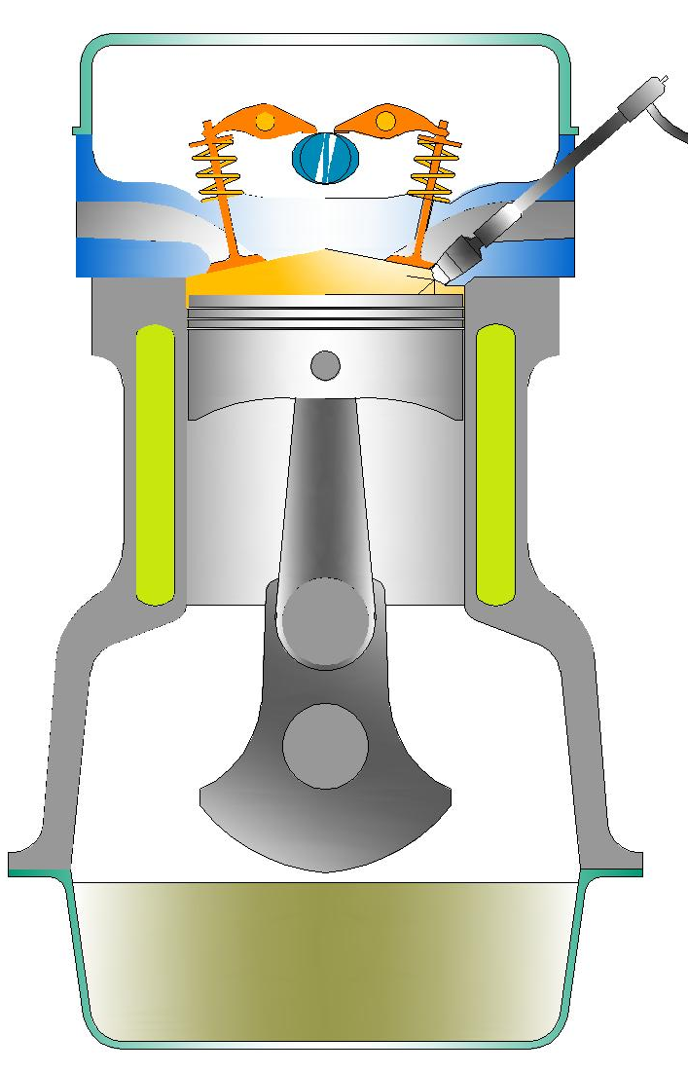
Compression Ignition
Air only compressed in piston
Fuel delivery: Direct injection
Compression Ratio: 15-20:1

Slide 5
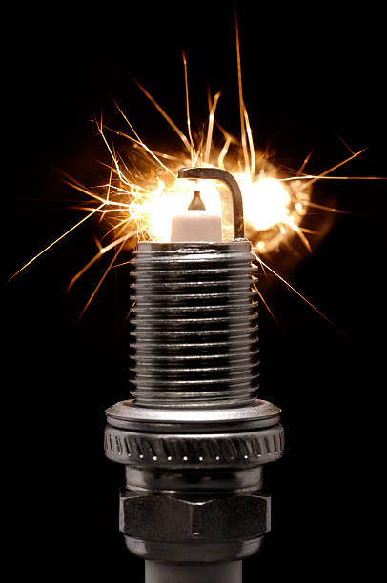
Spark Ignition Systems
AEN/TSM 220
Components
  Spark plug
  Coil
    Magnetism
    Induction
  Switching Device
  Power Source
System Types

Slide 6
Spark Plug

Slide 7
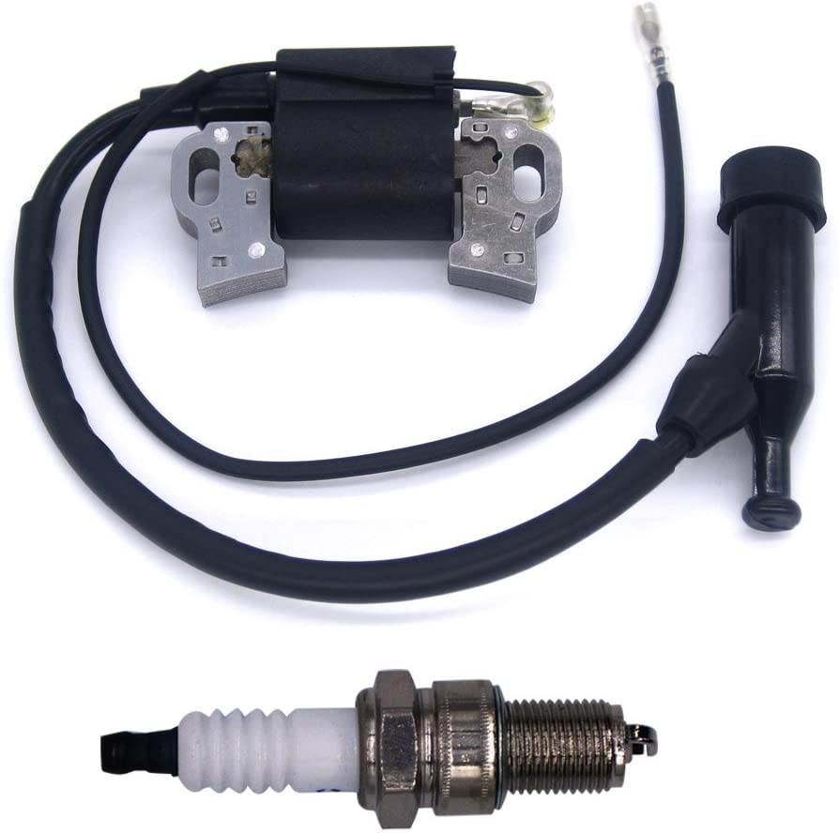
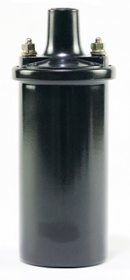
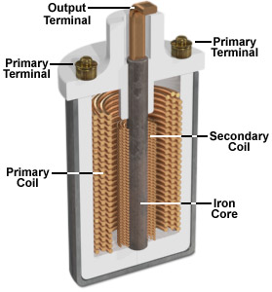
Magnetism and Coils
Current and magnetic fields
Transformers
Inductive kick

Slide 8
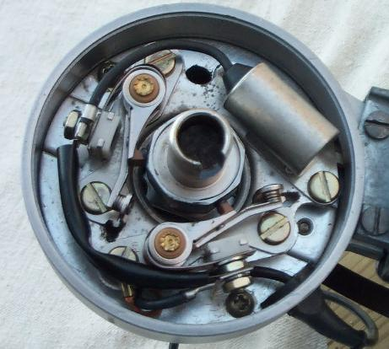
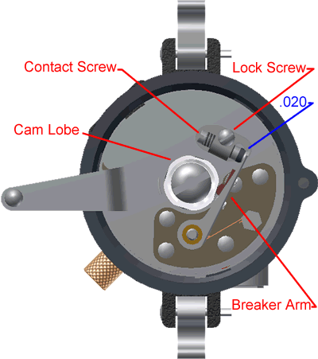
Switching device

Slide 9
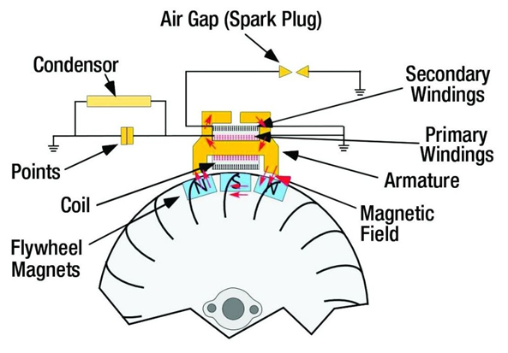
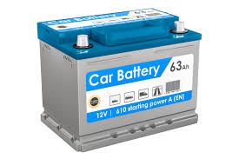
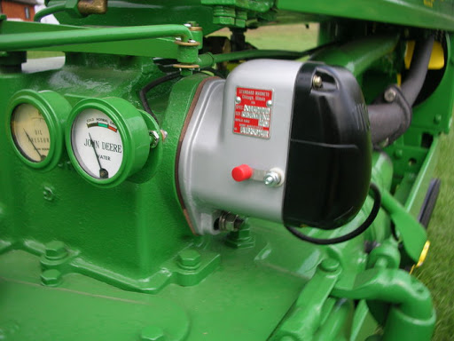
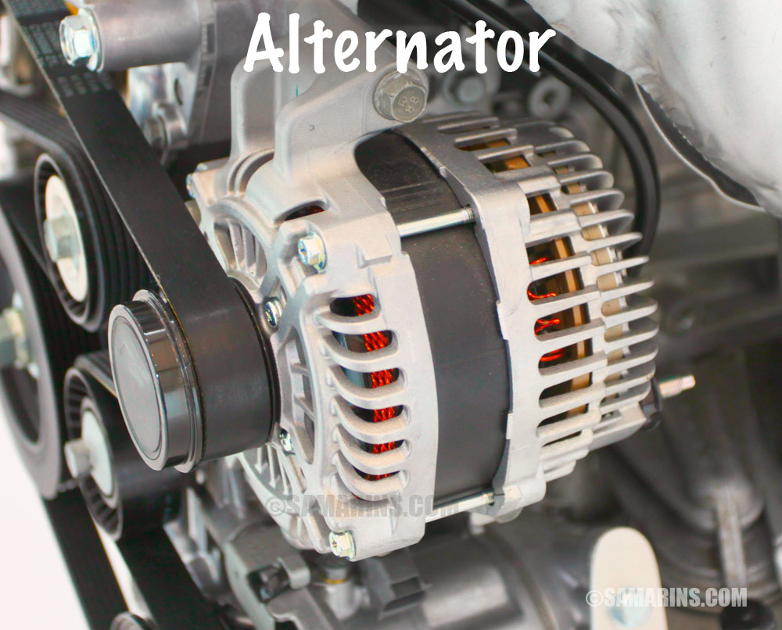
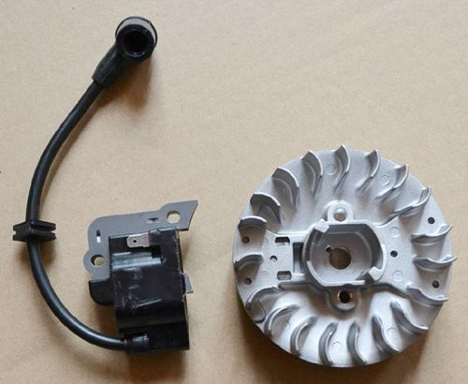
Power Source

Slide 10
Ignition System Types
Power Source
  Magneto
  Battery
Switching Type
  Mechanical Breaker point Ignition (MBI)
  Solid State
  Electronic

Slide 13
Magneto

Slide 14
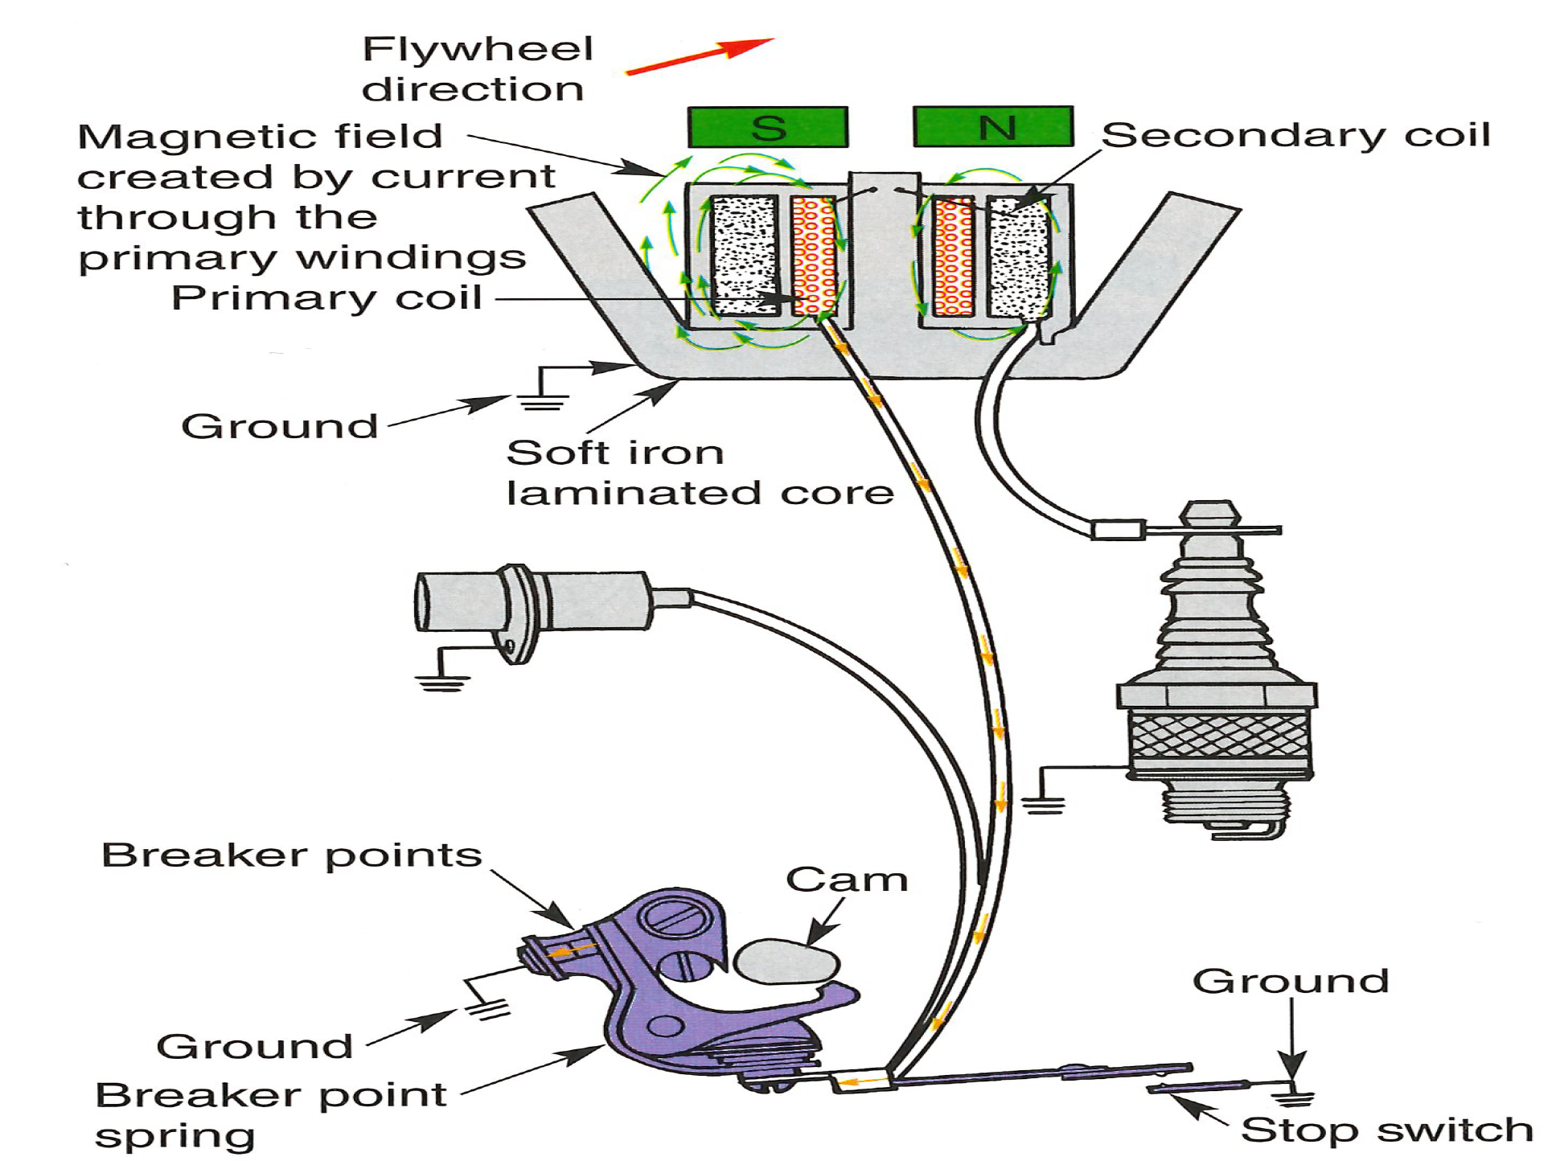

Slide 15
Timing

